Slide 1
Creating Functions and
Debugging Subprograms

Slide 2
Objectives
After completing this lesson, you should be able to do the following:
  Differentiate between a procedure and a function
  Describe the uses of functions
  Create stored functions
  Invoke a function
  Remove a function
  Understand the basic functionality of the SQL Developer debugger
Notes:
Oracle Database 11g: Develop PL/SQL Program Units 2 - <number>
Lesson Aim
In this lesson, you learn how to create, invoke, and maintain functions.

Slide 3
Lesson Agenda
  Working with functions:
    Differentiating between a procedure and a function
    Describing the uses of functions
    Creating, invoking, and removing stored functions
  Introducing the SQL Developer debugger
Notes:
Oracle Database 11g: Develop PL/SQL Program Units 2 - <number>

Slide 4
Overview of Stored Functions
A function:
  Is a named PL/SQL block that returns a value
  Can be stored in the database as a schema object for repeated execution
  Is called as part of an expression or is used to provide a parameter value for another subprogram
  Can be grouped into PL/SQL packages
Notes:
Oracle Database 11g: Develop PL/SQL Program Units 2 - <number>
Overview of Stored Functions
A function is a named PL/SQL block that can accept parameters, be invoked, and return a value. In general, you use a function to compute a value. Functions and procedures are structured alike. A function must return a value to the calling environment, whereas a procedure returns zero or more values to its calling environment. Like a procedure, a function has a header, a declarative section, an executable section, and an optional exception-handling section. A function must have a RETURN clause in the header and at least one RETURN statement in the executable section.
Functions can be stored in the database as schema objects for repeated execution. A function that is stored in the database is referred to as a stored function. Functions can also be created on client-side applications.
Functions promote reusability and maintainability. When validated, they can be used in any number of applications. If the processing requirements change, only the function needs to be updated.
A function may also be called as part of a SQL expression or as part of a PL/SQL expression. In the context of a SQL expression, a function must obey specific rules to control side effects. In a PL/SQL expression, the function identifier acts like a variable whose value depends on the parameters passed to it.
Functions (and procedures) can be grouped into PL/SQL packages. Packages make code even more reusable and maintainable. Packages are covered in the lessons titled “Creating Packages” and “Working with Packages.”

Slide 5
Creating Functions
The PL/SQL block must have at least one RETURN statement.
CREATE [OR REPLACE] FUNCTION function_name
[(parameter1 [mode1] datatype1, . . .)]
RETURN datatype IS|AS
[local_variable_declarations;
. . .]
BEGIN
-- actions;
RETURN expression;
END [function_name];
PL/SQL Block
Notes:
Oracle Database 11g: Develop PL/SQL Program Units 2 - <number>
Syntax for Creating Functions
A function is a PL/SQL block that returns a value. A RETURN statement must be provided to return a value with a data type that is consistent with the function declaration.
You create new functions with the CREATE FUNCTION statement, which may declare a list of parameters, must return one value, and must define the actions to be performed by the standard PL/SQL block.
You should consider the following points about the CREATE FUNCTION statement:
The REPLACE option indicates that if the function exists, it is dropped and replaced with the new version that is created by the statement.
The RETURN data type must not include a size specification.
The PL/SQL block starts with a BEGIN after the declaration of any local variables and ends with an END, optionally followed by the function_name.
There must be at least one RETURN expression statement.
You cannot reference host or bind variables in the PL/SQL block of a stored function.
Note: Although the OUT and IN OUT parameter modes can be used with functions, it is not good programming practice to use them with functions. However, if you need to return more than one value from a function, consider returning the values in a composite data structure such as a PL/SQL record or a PL/SQL table.

Slide 6
The Difference Between
Procedures and Functions
Procedures | Functions
Execute as a PL/SQL statement | Invoke as part of an expression
Do not contain RETURN clause in the header | Must contain a RETURN clause in the header
Can pass values (if any) using output parameters | Must return a single value
Can contain a RETURN statement without a value | Must contain at least one RETURN statement
Notes:
Oracle Database 11g: Develop PL/SQL Program Units 2 - <number>
The Difference Between Procedures and Functions
You create a procedure to store a series of actions for later execution. A procedure can contain zero or more parameters that can be transferred to and from the calling environment, but a procedure does not have to return a value. A procedure can call a function to assist with its actions.
Note: A procedure containing a single OUT parameter would be better rewritten as a function returning the value.
You create a function when you want to compute a value that must be returned to the calling environment. A function can contain zero or more parameters that are transferred from the calling environment. Functions typically return only a single value, and the value is returned through a RETURN statement. Functions used in SQL statements should not use OUT or IN OUT mode parameters. Although a function using output parameters can be used in a PL/SQL procedure or block, it cannot be used in SQL statements.

Slide 7

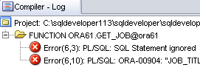










Creating and Running Functions: Overview
View errors/warnings
in SQL Developer
YES
Use SHOW ERRORS
command in SQL*Plus
Create/edit function
Compiler
warnings/errors?
View compiler
warnings/errors
NO
Use USER/ALL/DBA_
ERRORS views
Invoke function
Notes:
Oracle Database 11g: Develop PL/SQL Program Units 2 - <number>
Creating and Running Functions: Overview
The diagram in the slide illustrates the basic steps involved in creating and running a function:
1. Create the function using SQL Developer’s Object Navigator tree or the SQL Worksheet area.
2. Compile the function. The function is created in the database. The CREATE FUNCTION statement creates and stores source code and the compiled m-code in the database. To compile the function, right-click the function’s name in the Object Navigator tree, and then click Compile.
3. If there are compilation warning or errors, you can view (and then correct) the warnings or errors using one of the following methods:
a. Using the SQL Developer interface (the Compiler – Log tab)
b. Using the SHOW ERRORS SQL*Plus command
c. Using the USER/ALL/DBA_ERRORS views
4. After successful compilation, invoke the function to return the desired value.

Slide 8
Creating and Invoking a Stored Function Using the CREATE FUNCTION Statement: Example
CREATE OR REPLACE FUNCTION get_sal
(p_id employees.employee_id%TYPE) RETURN NUMBER IS
v_sal employees.salary%TYPE := 0;
BEGIN
SELECT salary
INTO v_sal
FROM employees
WHERE employee_id = p_id;
RETURN v_sal;
END get_sal;
/
-- Invoke the function as an expression or as
-- a parameter value.
EXECUTE dbms_output.put_line(get_sal(100))
Notes:
Oracle Database 11g: Develop PL/SQL Program Units 2 - <number>
Stored Function: Example
The get_sal function is created with a single input parameter and returns the salary as a number. Execute the command as shown, or save it in a script file and run the script to create the get_sal function.
The get_sal function follows a common programming practice of using a single RETURN statement that returns a value assigned to a local variable. If your function has an exception section, then it may also contain a RETURN statement.
Invoke a function as part of a PL/SQL expression because the function will return a value to the calling environment. The second code box uses the SQL*Plus EXECUTE command to call the DBMS_OUTPUT.PUT_LINE procedure whose argument is the return value from the function get_sal. In this case, get_sal is invoked first to calculate the salary of the employee with ID 100. The salary value returned is supplied as the value of the DBMS_OUTPUT.PUT_LINE parameter, which displays the result (if you have executed a SET SERVEROUTPUT ON).
Note: A function must always return a value. The example does not return a value if a row is not found for a given id. Ideally, create an exception handler to return a value as well.

Slide 9

Using Different Methods for Executing Functions
-- As a PL/SQL expression, get the results using host variables
VARIABLE b_salary NUMBER
EXECUTE :b_salary := get_sal(100)
-- As a PL/SQL expression, get the results using a local
-- variable
SET SERVEROUTPUT ON
DECLARE
sal employees.salary%type;
BEGIN
sal := get_sal(100);
DBMS_OUTPUT.PUT_LINE('The salary is: '|| sal);
END;
/
Notes:
Oracle Database 11g: Develop PL/SQL Program Units 2 - <number>
Using Different Methods for Executing Functions
If functions are well designed, they can be powerful constructs. Functions can be invoked in the following ways:
As part of PL/SQL expressions: You can use host or local variables to hold the returned value from a function. The first example in the slide uses a host variable and the second example uses a local variable in an anonymous block.
Note: The benefits and restrictions that apply to functions when used in a SQL statement are discussed on the next few pages.

Slide 10
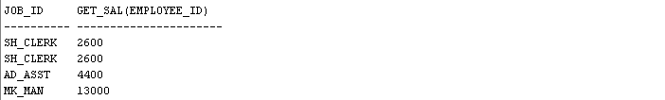

Using Different Methods for Executing Functions
-- Use as a parameter to another subprogram
EXECUTE dbms_output.put_line(get_sal(100))
-- Use in a SQL statement (subject to restrictions)
SELECT job_id, get_sal(employee_id)
FROM employees;
. . .
Notes:
Oracle Database 11g: Develop PL/SQL Program Units 2 - <number>
Using Different Methods for Executing Functions (continued)
As a parameter to another subprogram: The first example in the slide demonstrates this usage. The get_sal function with all its arguments is nested in the parameter required by the DBMS_OUTPUT.PUT_LINE procedure. This comes from the concept of nesting functions as discussed in the course titled Oracle Database 11g: SQL Fundamentals I.
As an expression in a SQL statement: The second example in the slide shows how a function can be used as a single-row function in a SQL statement.

Slide 11
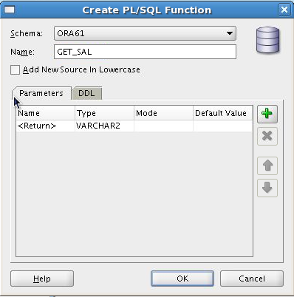
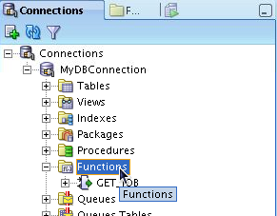
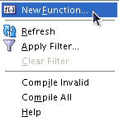
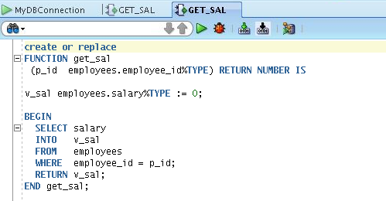
Creating and Compiling
Functions Using SQL Developer
2
3
1
5
4
Notes:
Oracle Database 11g: Develop PL/SQL Program Units 2 - <number>
Creating and Compiling Functions Using SQL Developer
You can create a new function in SQL Developer using the following steps:
1. Right-click the Functions node.
2. Select New Function from the shortcut menu. The Create PL/SQL Function dialog box is displayed.
3. Select the schema, function name, and the parameters list (using the + icon), and then click OK. The code editor for the function is displayed.
4. Enter the function’s code.
5. To compile the function, click the Compile icon.
Note
To create a new function in SQL Developer, you can also enter the code in the SQL Worksheet, and then click the Run Script icon.
For additional information about creating functions in SQL Developer, access the appropriate online help topic titled “Create PL/SQL Subprogram Function or Procedure.”

Slide 12
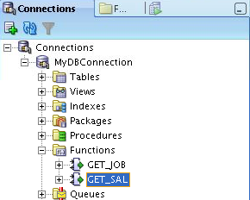
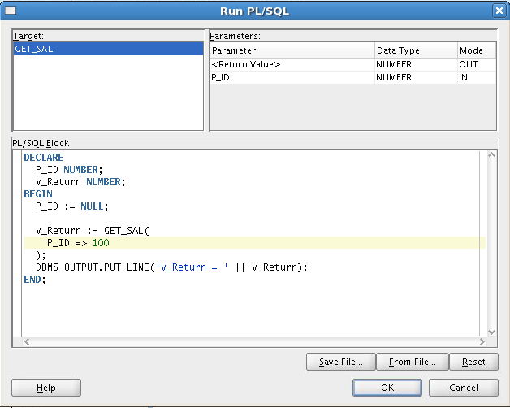
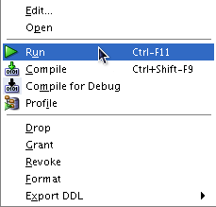
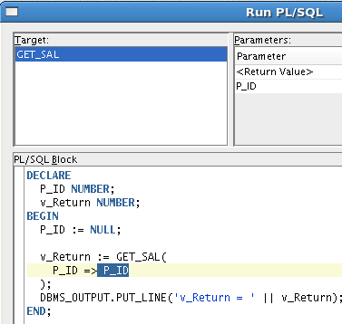
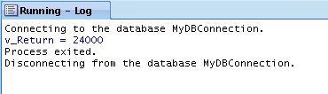
Executing Functions Using SQL Developer
1
2
Replace the second
P_ID with the actual
value, 100
4
3
Notes:
Oracle Database 11g: Develop PL/SQL Program Units 2 - <number>
Executing Functions Using SQL Developer
You can execute a function in SQL Developer using the following steps:
1. Click the Functions node.
2. Right-click the function’s name, and then select Run. The Run PL/SQL dialog box is displayed.
3. Replace the second parameter name with the actual parameter value as shown in the slide example.
4. Click OK.
Note: For additional information about running functions in SQL Developer, access the online help topic titled “Running and Debugging Functions and Procedures.”

Slide 13
Advantages of User-Defined
Functions in SQL Statements
  Can extend SQL where activities are too complex, too awkward, or unavailable with SQL
  Can increase efficiency when used in the WHERE clause to filter data, as opposed to filtering the data in the application
  Can manipulate data values
Notes:
Oracle Database 11g: Develop PL/SQL Program Units 2 - <number>
Advantages of User-Defined Functions in SQL Statements
SQL statements can reference PL/SQL user-defined functions anywhere a SQL expression is allowed. For example, a user-defined function can be used anywhere that a built-in SQL function, such as UPPER(), can be placed.
Advantages
Permits calculations that are too complex, awkward, or unavailable with SQL. Functions increase data independence by processing complex data analysis within the Oracle server, rather than by retrieving the data into an application
Increases efficiency of queries by performing functions in the query rather than in the application
Manipulates new types of data (for example, latitude and longitude) by encoding character strings and using functions to operate on the strings

Slide 14
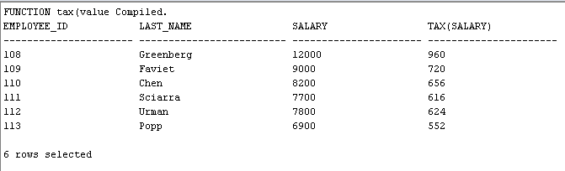
Using a Function in a SQL Expression: Example
CREATE OR REPLACE FUNCTION tax(p_value IN NUMBER)
RETURN NUMBER IS
BEGIN
RETURN (p_value * 0.08);
END tax;
/
SELECT employee_id, last_name, salary, tax(salary)
FROM employees
WHERE department_id = 100;
Notes:
Oracle Database 11g: Develop PL/SQL Program Units 2 - <number>
Function in SQL Expressions: Example
The example in the slide shows how to create a tax function to calculate income tax. The function accepts a NUMBER parameter and returns the calculated income tax based on a simple flat tax rate of 8%.
To execute the code shown in the slide example in SQL Developer, enter the code in the SQL Worksheet, and then click the Run Script icon. The tax function is invoked as an expression in the SELECT clause along with the employee ID, last name, and salary for employees in a department with ID 100. The return result from the tax function is displayed with the regular output from the query.

Slide 15
Calling User-Defined Functions in SQL Statements
User-defined functions act like built-in single-row functions and can be used in:
  The SELECT list or clause of a query
  Conditional expressions of the WHERE and HAVING clauses
  The CONNECT BY, START WITH, ORDER BY, and GROUP BY clauses of a query
  The VALUES clause of the INSERT statement
  The SET clause of the UPDATE statement
Notes:
Oracle Database 11g: Develop PL/SQL Program Units 2 - <number>
Calling User-Defined Functions in SQL Statements
A PL/SQL user-defined function can be called from any SQL expression where a built-in single-row function can be called as shown in the following example:
SELECT employee_id, tax(salary)
FROM employees
WHERE tax(salary) > (SELECT MAX(tax(salary))
FROM employees
WHERE department_id = 30)
ORDER BY tax(salary) DESC;

Slide 16
Restrictions When Calling Functions from SQL Expressions
  User-defined functions that are callable from SQL expressions must:
    Be stored in the database
    Accept only IN parameters with valid SQL data types, not PL/SQL-specific types
    Return valid SQL data types, not PL/SQL-specific types
  When calling functions in SQL statements:
    You must own the function or have the EXECUTE privilege
    You may need to enable the PARALLEL_ENABLE keyword to allow a parallel execution of the SQL statement
Notes:
Oracle Database 11g: Develop PL/SQL Program Units 2 - <number>
Restrictions When Calling Functions from SQL Expressions
The user-defined PL/SQL functions that are callable from SQL expressions must meet the following requirements:
The function must be stored in the database.
The function parameters must be IN and of valid SQL data types.
The functions must return data types that are valid SQL data types. They cannot be PL/SQL-specific data types such as BOOLEAN, RECORD, or TABLE. The same restriction applies to the parameters of the function.
The following restrictions apply when calling a function in a SQL statement:
Parameters must use positional notation. Named notation is not supported.
You must own or have the EXECUTE privilege on the function.
You may need to enable the PARALLEL_ENABLE keyword to allow a parallel execution of the SQL statement using the function. Each parallel slave will have private copies of the function’s local variables.
Other restrictions on a user-defined function include the following: It cannot be called from the CHECK constraint clause of a CREATE TABLE or ALTER TABLE statement. In addition, it cannot be used to specify a default value for a column. Only stored functions are callable from SQL statements. Stored procedures cannot be called unless invoked from a function that meets the preceding requirements.

Slide 17
Controlling Side Effects When
Calling Functions from SQL Expressions
Functions called from:
  A SELECT statement cannot contain DML statements
  An UPDATE or DELETE statement on a table T cannot query or contain DML on the same table T
  SQL statements cannot end transactions (that is, cannot execute COMMIT or ROLLBACK operations)
Note: Calls to subprograms that break these restrictions are also not allowed in the function.
Notes:
Oracle Database 11g: Develop PL/SQL Program Units 2 - <number>
Controlling Side Effects When Calling Functions from SQL Expressions
To execute a SQL statement that calls a stored function, the Oracle server must know whether the function is free of specific side effects. The side effects are unacceptable changes to database tables.
Additional restrictions apply when a function is called in expressions of SQL statements:
When a function is called from a SELECT statement or a parallel UPDATE or DELETE statement, the function cannot modify database tables.
When a function is called from an UPDATE or DELETE statement, the function cannot query or modify database tables modified by that statement.
When a function is called from a SELECT, INSERT, UPDATE, or DELETE statement, the function cannot execute directly or indirectly through another subprogram or SQL transaction control statements such as:
A COMMIT or ROLLBACK statement
A session control statement (such as SET ROLE)
A system control statement (such as ALTER SYSTEM)
Any DDL statements (such as CREATE) because they are followed by an automatic commit

Slide 18
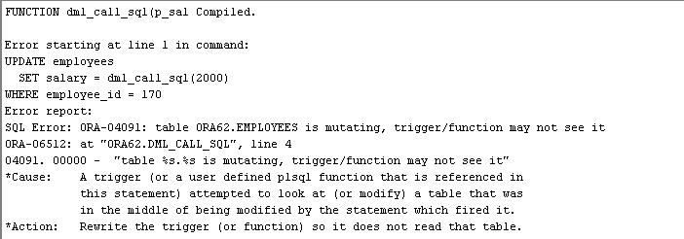
Restrictions on Calling Functions from SQL: Example
CREATE OR REPLACE FUNCTION dml_call_sql(p_sal NUMBER)
RETURN NUMBER IS
BEGIN
INSERT INTO employees(employee_id, last_name,
email, hire_date, job_id, salary)
VALUES(1, 'Frost', 'jfrost@company.com',
SYSDATE, 'SA_MAN', p_sal);
RETURN (p_sal + 100);
END;
UPDATE employees
SET salary = dml_call_sql(2000)
WHERE employee_id = 170;
Notes:
Oracle Database 11g: Develop PL/SQL Program Units 2 - <number>
Restrictions on Calling Functions from SQL: Example
The dml_call_sql function in the slide contains an INSERT statement that inserts a new record into the EMPLOYEES table and returns the input salary value incremented by 100. This function is invoked in the UPDATE statement that modifies the salary of employee 170 to the amount returned from the function. The UPDATE statement fails with an error indicating that the table is mutating (that is, changes are already in progress in the same table). In the following example, the query_call_sql function queries the SALARY column of the EMPLOYEES table:
CREATE OR REPLACE FUNCTION query_call_sql(p_a NUMBER)
RETURN NUMBER IS
v_s NUMBER;
BEGIN
SELECT salary INTO v_s FROM employees
WHERE employee_id = 170;
RETURN (v_s + p_a);
END;
When invoked from the following UPDATE statement, it returns the error message similar to the error message shown in the slide:
UPDATE employees SET salary = query_call_sql(100)
WHERE employee_id = 170;

Slide 19
Named and Mixed Notation from SQL
  PL/SQL allows arguments in a subroutine call to be specified using positional, named, or mixed notation.
  Prior to Oracle Database 11g, only the positional notation is supported in calls from SQL.
  Starting in Oracle Database 11g, named and mixed notation can be used for specifying arguments in calls to PL/SQL subroutines from SQL statements.
  For long parameter lists, with most having default values, you can omit values from the optional parameters.
  You can avoid duplicating the default value of the optional parameter at each call site.
Notes:
Oracle Database 11g: Develop PL/SQL Program Units 2 - <number>

Slide 20

Named and Mixed Notation from SQL: Example
CREATE OR REPLACE FUNCTION f(
p_parameter_1 IN NUMBER DEFAULT 1,
p_parameter_5 IN NUMBER DEFAULT 5)
RETURN NUMBER
IS
v_var number;
BEGIN
v_var := p_parameter_1 + (p_parameter_5 * 2);
RETURN v_var;
END f;
/
SELECT f(p_parameter_5 => 10) FROM DUAL;
Notes:
Oracle Database 11g: Develop PL/SQL Program Units 2 - <number>
Example of Using Named and Mixed Notation from a SQL Statement
In the example in the slide, the call to the function f within the SQL SELECT statement uses the named notation. Before Oracle Database 11g, you could not use the named or mixed notation when passing parameters to a function from within a SQL statement. Before Oracle Database 11g, you received the following error:
SELECT f(p_parameter_5 => 10) FROM DUAL;
ORA-00907: missing right parenthesis

Slide 21
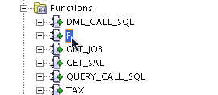
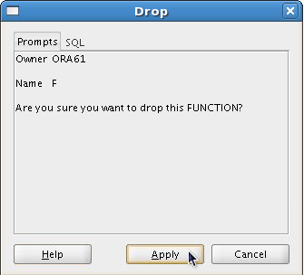
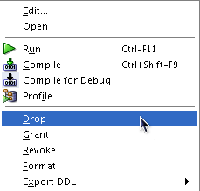
Removing Functions: Using the DROP
SQL Statement or SQL Developer
  Using the DROP statement:
  Using SQL Developer:
DROP FUNCTION f;
1
2
3
Notes:
Oracle Database 11g: Develop PL/SQL Program Units 2 - <number>
Removing Functions
Using the DROP statement
When a stored function is no longer required, you can use a SQL statement in SQL*Plus to drop it. To remove a stored function by using SQL*Plus, execute the DROP FUNCTION SQL command.
Using CREATE OR REPLACE Versus DROP and CREATE
The REPLACE clause in the CREATE OR REPLACE syntax is equivalent to dropping a function and re-creating it. When you use the CREATE OR REPLACE syntax, the privileges granted on this object to other users remain the same. When you DROP a function and then re-create it, all the privileges granted on this function are automatically revoked.
Using SQL Developer
To drop a function in SQL Developer, right-click the function name in the Functions node, and then select Drop. The Drop dialog box is displayed. To drop the function, click Apply.

Slide 22
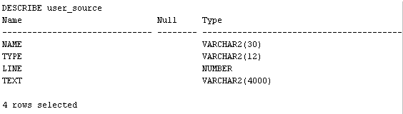
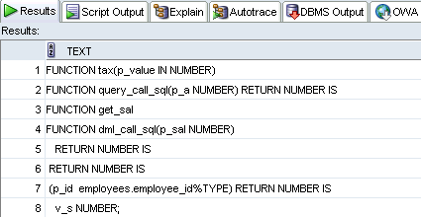
Viewing Functions
Using Data Dictionary Views
DESCRIBE USER_SOURCE
SELECT text
FROM user_source
WHERE type = 'FUNCTION'
ORDER BY line;
. . .
Notes:
Oracle Database 11g: Develop PL/SQL Program Units 2 - <number>
Viewing Functions Using Data Dictionary Views
The source code for PL/SQL functions is stored in the data dictionary tables. The source code is accessible for PL/SQL functions that are successfully or unsuccessfully compiled. To view the PL/SQL function code stored in the data dictionary, execute a SELECT statement on the following tables where the TYPE column value is FUNCTION:
The USER_SOURCE table to display the PL/SQL code that you own
The ALL_SOURCE table to display the PL/SQL code to which you have been granted the EXECUTE right by the owner of that subprogram code
The second example in the slide uses the USER_SOURCE table to display the source code for all the functions in your schema.
You can also use the USER_OBJECTS data dictionary view to display a list of your function names.
Note: The output of the second code example in the slide was generated using the Execute Statement (F9) icon on the toolbar to provide better-formatted output.

Slide 23
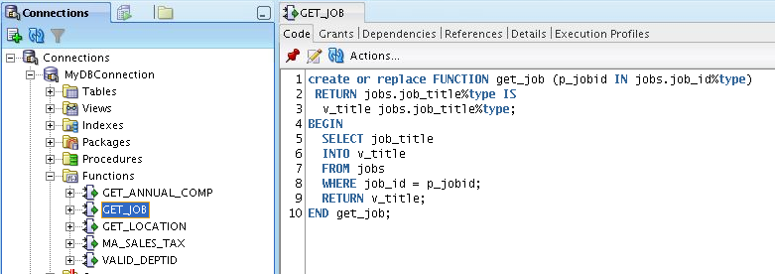
Viewing Functions Information
Using SQL Developer
1
3
2
Notes:
Oracle Database 11g: Develop PL/SQL Program Units 2 - <number>
Viewing Functions Information Using SQL Developer
To view a function’s code in SQL Developer, use the following steps:
1. Click the Functions node in the Connections tab.
2. Click the function’s name.
3. The function's code is displayed in the Code tab as shown in the slide.

Slide 24
Quiz
A PL/SQL stored function:
  Can be invoked as part of an expression
  Must contain a RETURN clause in the header
  Must return a single value
  Must contain at least one RETURN statement
  Does not contain a RETURN clause in the header
Notes:
Oracle Database 11g: Develop PL/SQL Program Units 2 - <number>
Answers: 1, 2, 3, 4

Slide 25
Practice 2-1: Overview
This practice covers the following topics:
  Creating stored functions:
    To query a database table and return specific values
    To be used in a SQL statement
    To insert a new row, with specified parameter values, into a database table
    Using default parameter values
  Invoking a stored function from a SQL statement
  Invoking a stored function from a stored procedure
Notes:
Oracle Database 11g: Develop PL/SQL Program Units 2 - <number>
Practice 2-1: Overview
It is recommended to use SQL Developer for this practice.

Slide 26
Lesson Agenda
  Working with functions:
    Differentiating between a procedure and a function
    Describing the uses of functions
    Creating, invoking, and removing stored functions
  Introducing the SQL Developer debugger
Notes:
Oracle Database 11g: Develop PL/SQL Program Units 2 - <number>

Slide 27
Debugging PL/SQL Subprograms
Using the SQL Developer Debugger
  You can use the debugger to control the execution of your PL/SQL program.
  To debug a PL/SQL subprogram, a security administrator needs to grant the following privileges to the application developer:
    DEBUG ANY PROCEDURE
    DEBUG CONNECT SESSION
GRANT DEBUG ANY PROCEDURE TO ora61;
GRANT DEBUG CONNECT SESSION TO ora61;
Notes:
Oracle Database 11g: Develop PL/SQL Program Units 2 - <number>
Moving Through Code While Debugging
The SQL Developer debugger enables you to control the execution of your program. You can control whether your program executes a single line of code, an entire subprogram (procedure or function), or an entire program block. By manually controlling when the program should run and when it should pause, you can quickly move over the sections that you know work correctly and concentrate on the sections that are causing problems.

Slide 28
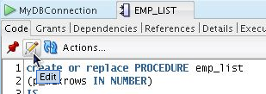
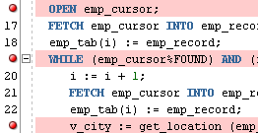
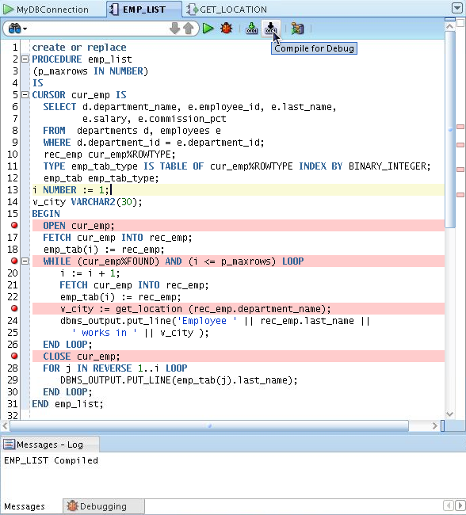
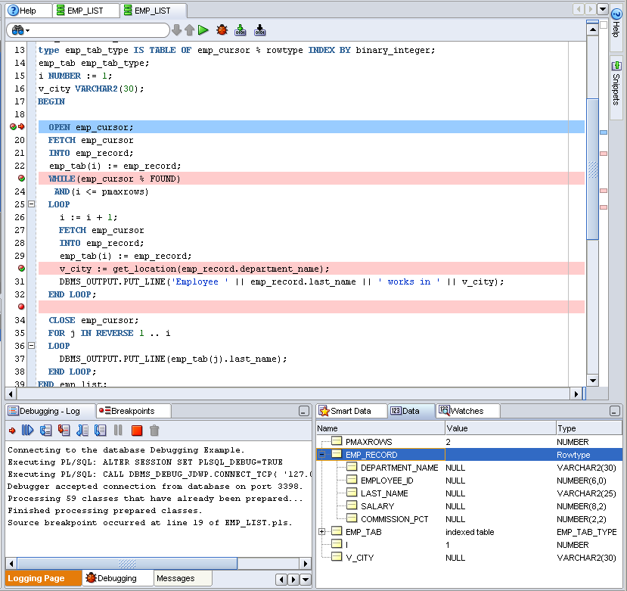
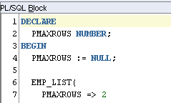
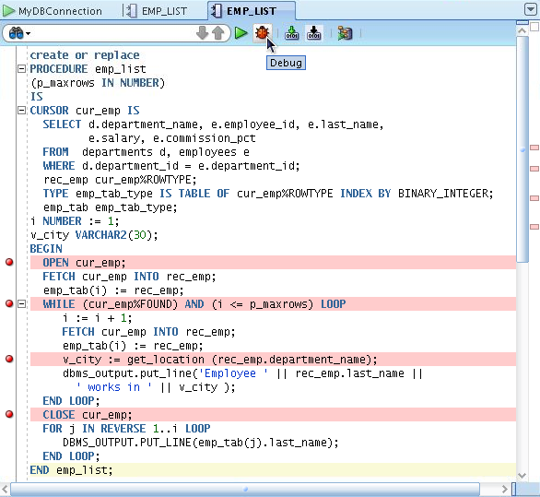
Debugging a Subprogram: Overview
1. Edit procedure
2. Add breakpoints
3. Compile for Debug
6. Choose debugging tool,
and monitor data
5. Enter parameter
value(s)
4. Debug
Notes:
Oracle Database 11g: Develop PL/SQL Program Units 2 - <number>

Slide 29
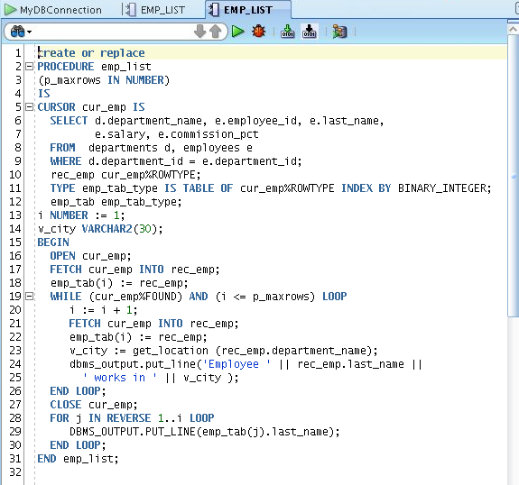
The Procedure or Function Code Editing Tab
Notes:
Oracle Database 11g: Develop PL/SQL Program Units 2 - <number>
The Procedure or Function Code Tab
This tab displays a toolbar and the text of the subprogram, which you can edit. You can set and unset breakpoints for debugging by clicking to the left of the thin vertical line beside each statement with which you want to associate a breakpoint. (When a breakpoint is set, a red circle is displayed.)

Slide 30
The Procedure or Function Tab Toolbar
3
5
1
2
4
Icon | Description
1. Run | Starts normal execution of the function or procedure, and displays the results in the Running - Log tab
2. Debug | Executes the subprogram in debug mode, and displays the Debugging - Log tab, which includes the debugging toolbar for controlling execution
3. Compile | Compiles the subprogram
4. Compile for Debug | Compiles the subprogram so that it can be debugged
5. Profile | Displays the Profile window that you use to specify parameter values for running, debugging, or profiling a PL/SQL function or procedure
Notes:
Oracle Database 11g: Develop PL/SQL Program Units 2 - <number>

Slide 31
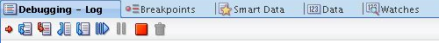
The Debugging – Log Tab Toolbar
3
1
2
4
Icon | Description
1. Find Execution Point | Goes to the next execution point
2. Step Over | Bypasses the next subprogram and goes to the next statement after the subprogram
3. Step Into | Executes a single program statement at a time. If the execution point is located on a call to a subprogram, it steps into the first statement in that subprogram
4. Step Out | Leaves the current subprogram and goes to the next statement with a breakpoint
Notes:
Oracle Database 11g: Develop PL/SQL Program Units 2 - <number>
The Debugging – Log Tab Toolbar
The Debugging - Log contains the debugging toolbar and informational messages.
1. Find Execution Point: Goes to the execution point (the next line of source code to be executed by the debugger)
2. Step Over: Bypasses the next subprogram (unless the subprogram has a breakpoint) and goes to the next statement after the subprogram. If the execution point is located on a subprogram call, it runs that subprogram without stopping (instead of stepping into it), and then positions the execution point on the statement that follows the call. If the execution point is located on the last statement of a subprogram, Step Over returns from the subprogram, placing the execution point on the line of code that follows the call to the subprogram from which you are returning.
3. Step Into: Executes a single program statement at a time. If the execution point is located on a call to a subprogram, Step Into steps into that subprogram and places the execution point on its first statement. If the execution point is located on the last statement of a subprogram, Step Into returns from the subprogram, placing the execution point on the line of code that follows the call to the subprogram from which you are returning.
4. Step Out: Leaves the current subprogram and goes to the next statement

Slide 32
The Debugging – Log Tab Toolbar
5
7
6
8
Icon | Description
5. Step to End of Method | Goes to the last statement of the current subprogram
6. Resume | Continues execution
7. Pause | Halts execution but does not exit
8. Terminate | Halts and exits the execution
Notes:
Oracle Database 11g: Develop PL/SQL Program Units 2 - <number>
The Debugging – Log Tab Toolbar (continued)
5. Step to End of Method: Goes to the last statement of the current subprogram
6. Resume: Continues execution
7. Pause: Halts execution but does not exit, thus allowing you to resume execution
8. Terminate: Halts and exits the execution. You cannot resume execution from this point; instead, to start running or debugging from the beginning of the subprogram, click the Run or Debug icon in the Source tab toolbar.

Slide 33
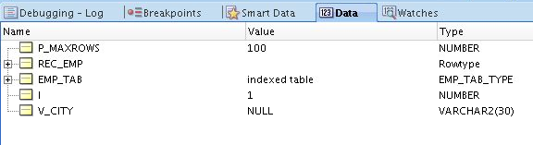
Additional Tabs
Tab | Description
Breakpoints | Displays breakpoints, both system-defined and user-defined.
Smart Data | Displays information about variables. You can specify these preferences by right-clicking in the Smart Data window and selecting Preferences.
Data | Located under the code text area; displays information about all variables
Watches | Located under the code text area; displays information about watches
Notes:
Oracle Database 11g: Develop PL/SQL Program Units 2 - <number>
Additional Tabs
Setting Expression Watches
A watch enables you to monitor the changing values of variables or expressions as your program runs. After you enter a watch expression, the Watches window displays the current value of the expression. As your program runs, the value of the watch changes as your program updates the values of the variables in the watch expression.
A watch evaluates an expression according to the current context, which is controlled by the selection in the Stack window. If you move to a new context, the expression is reevaluated for the new context. If the execution point moves to a location where any of the variables in the watch expression are undefined, the entire watch expression becomes undefined. If the execution point returns to a location where the watch expression can be evaluated, the Watches window again displays the value of the watch expression.
To open the Watches window, click View, then Debugger, then Watches.
To add a watch, right-click in the Watches window and select Add Watch. To edit a watch, right-click in the Watches window and select Edit Watch.
Note: If you cannot see some of the debugging tabs described in this lesson, you can re-display such tabs by using the View > Debugger menu option.

Slide 34
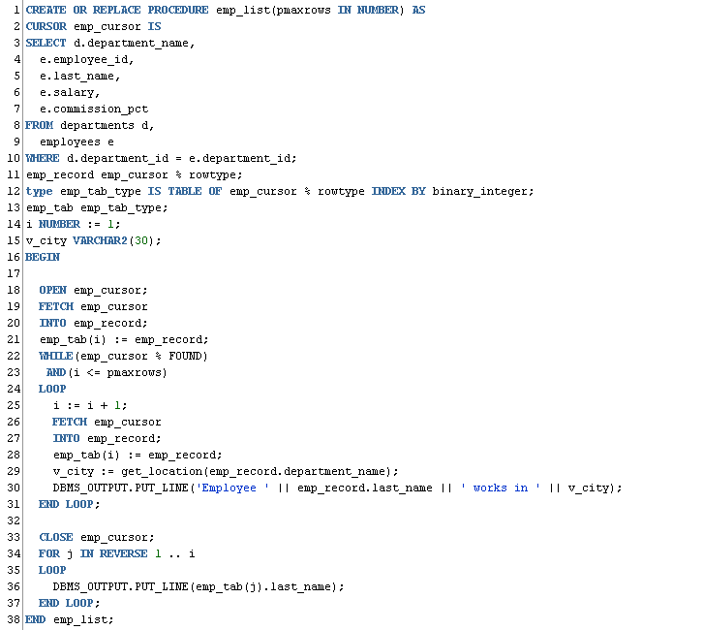
Debugging a Procedure Example:
Creating a New emp_list Procedure
Notes:
Oracle Database 11g: Develop PL/SQL Program Units 2 - <number>
Debugging a Procedure Example: Creating a New emp_list Procedure
The emp_list procedure gathers employee information such the employee’s department name, ID, name, salary, and commission percentage. The procedure creates a record to store the employee’s information. The procedure also creates a table that can hold multiple records of employees. “i” is a counter.
The code opens the cursor and fetches the employees’ records. The code also checks whether or not there are more records to fetch or whether the number of records fetched so far is less than the number of records that you specify. The code eventually prints out the employees’ information. The procedure also calls the get_location function that returns the name of the city in which an employee works.
Note: Make sure that you are displaying the procedure code in edit mode. To edit the procedure code, click the Edit icon on the procedure’s toolbar.

Slide 35
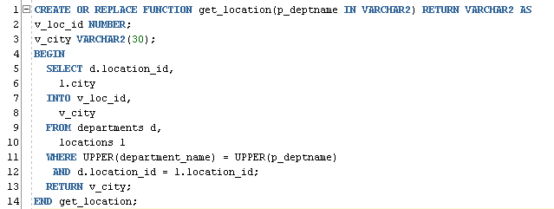
Debugging a Procedure Example:
Creating a New get_location Function
Notes:
Oracle Database 11g: Develop PL/SQL Program Units 2 - <number>
Debugging a Procedure Example: Creating a New Procedure
This function returns the city in which an employee works. It is called from the emp_list procedure.

Slide 36
Setting Breakpoints and Compiling emp_list for Debug Mode
Notes:
Oracle Database 11g: Develop PL/SQL Program Units 2 - <number>
Setting Breakpoints and Compiling emp_list for Debug Mode
In the example in the slide, the emp_list procedure is displayed in edit mode, and four breakpoints are added to various locations in the code. To compile the procedure for debugging, right-click the code, and then select Compile for Debug from the shortcut menu. The Messages – Log tab displays the message that the procedure was compiled.

Slide 37
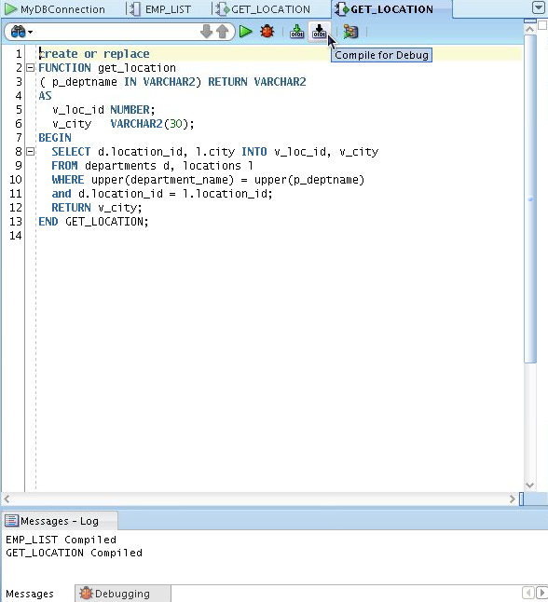
Compiling the get_location
Function for Debug Mode
Notes:
Oracle Database 11g: Develop PL/SQL Program Units 2 - <number>
Compiling the get_location Function for Debug Mode
In the example in the slide, the get_location function is displayed in edit mode. To compile the function for debugging, right-click the code, and then select Compile for Debug from the shortcut menu. The Messages – Log tab displays the message that the function was compiled.

Slide 38
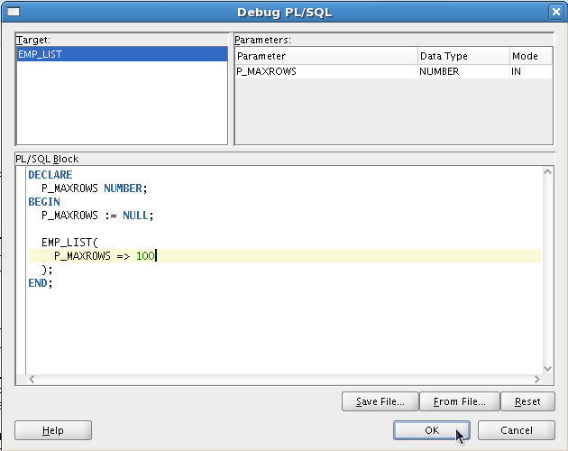
Debugging emp_list and Entering
Values for the PMAXROWS Parameter
Enter the procedure’s
parameter value using the
anonymous block.
Notes:
Oracle Database 11g: Develop PL/SQL Program Units 2 - <number>
Debugging emp_list and Entering Values for the PMAXROWS Parameter
The next step in the debugging process is to debug the procedure using any of the several available methods mentioned earlier, such as clicking the Debug icon on the procedure’s toolbar. An anonymous block is displayed, where you are prompted to enter the parameters for this procedure. emp_list has one parameter, PMAXROWS, which specifies the number of records to return. Replace the second PMAXROWS with a number such as 100, and then click OK.

Slide 39
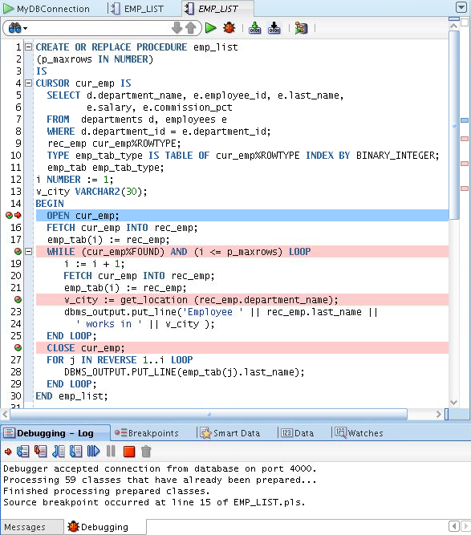
Debugging emp_list: Step Into (F7) the Code
1
Program
control stops at
first breakpoint.
Notes:
Oracle Database 11g: Develop PL/SQL Program Units 2 - <number>
The Step Into Debugging Tool
The Step Into command executes a single program statement at a time. If the execution point is located on a call to a subprogram, the Step Into command steps into that subprogram and places the execution point on the subprogram’s first statement. If the execution point is located on the last statement of a subprogram, choosing Step Into causes the debugger to return from the subprogram, placing the execution point on the line of code that follows the call to the subprogram you are returning from. The term single stepping refers to using Step Into to run successively though the statements in your program code. You can step into a subprogram in any of the following ways: Select Debug > Step Into, press F7, or click the Step Into icon in the Debugging – Log toolbar.
In the example in the slide, the program control is stopped at the first breakpoint in the code. The arrow next to the breakpoint indicated that this is the line of code that will be executed next. Note the various tabs at the bottom of the window.
Note: The Step Into and Step Over commands offer the simplest way of moving through your program code. While the two commands are very similar, they each offer a different way to control code execution.

Slide 40
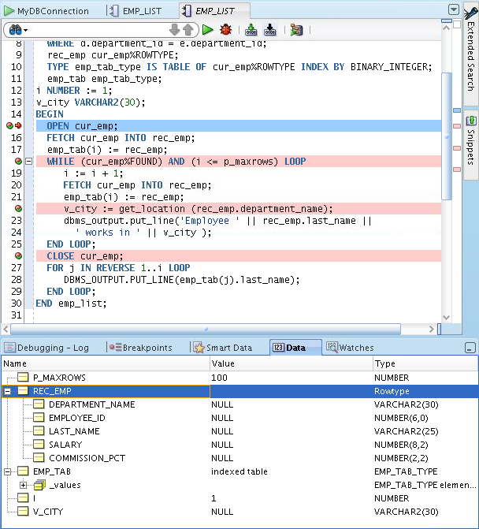

Debugging emp_list: Step Into (F7) the Code
1
2
Step Into (F7):
Steps into and
executes the cursor
code. Control is
transferred to
cursor definition.
3
Notes:
Oracle Database 11g: Develop PL/SQL Program Units 2 - <number>
Debugging emp_list: Step Into the Code
Selecting the Step Into command executes a single program statement at a time. If the execution point is located on a call to a subprogram, the Step Into command steps into that subprogram and places the execution at the first statement in the subprogram.
In the example in the slide, pressing F7 executes the line of code at the first breakpoint. In this case, program control is transferred to the section where the cursor is defined.

Slide 41

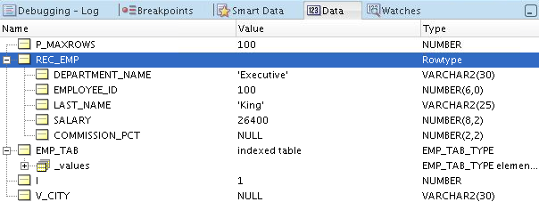
Viewing the Data
Notes:
Oracle Database 11g: Develop PL/SQL Program Units 2 - <number>
Viewing the Data
While you are debugging your code, you can use the Data tab to display and modify the variables. You can also set watches to monitor a subset of the variables displayed in the Data tab. To display or hide the Data, Smart Data, and Watch tabs: Select View > Debugger, and then select the tabs that you want to display or hide.

Slide 42
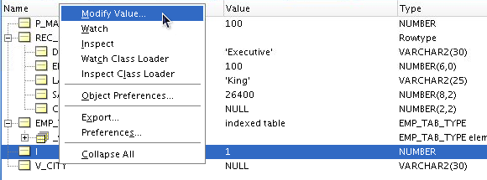
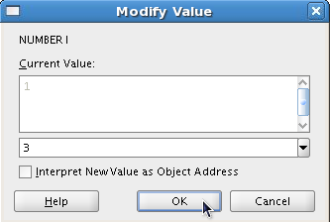
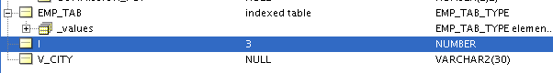
Modifying the Variables
While Debugging the Code
2
1
3
4
Notes:
Oracle Database 11g: Develop PL/SQL Program Units 2 - <number>
Modifying the Variables While Debugging the Code
To modify the value of a variable in the Data tab, right-click the variable name, and then select Modify Value from the shortcut menu. The Modify Value window is displayed. The current value for the variable is displayed. You can enter a new value in the second text box, and then click OK.

Slide 43
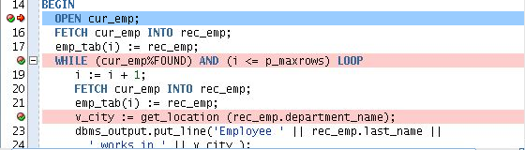
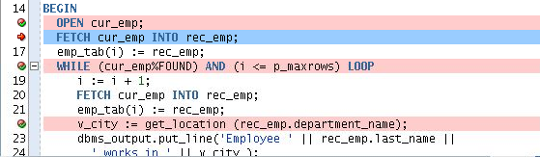
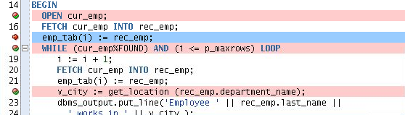
Debugging emp_list: Step Over the Code
1
F8
Step Over (F8):
Executes the Cursor
(same as F7),
but control is not transferred
to Open Cursor code
2
F8
3
Notes:
Oracle Database 11g: Develop PL/SQL Program Units 2 - <number>
The Step Over Debugging Tool
The Step Over command, like Step Into, enables you to execute program statements one at a time. However, if you issue the Step Over command when the execution point is located on a subprogram call, the debugger runs that subprogram without stopping (instead of stepping into it), and then positions the execution point on the statement that follows the subprogram call. If the execution point is located on the last statement of a subprogram, choosing Step Over causes the debugger to return from the subprogram, placing the execution point on the line of code that follows the call to the subprogram you are returning from. You can step over a subprogram in any of the following ways: Select Debug > Step Over, press F8, or click the Step Over icon in the Debugging – Log toolbar.
In the example in the slide, stepping over will execute the open cursor line without transferring program control to the cursor definition as was the case with the Step Into option example.

Slide 44
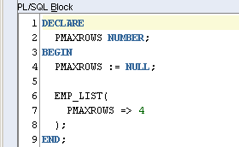
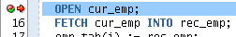
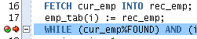

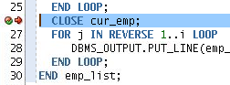
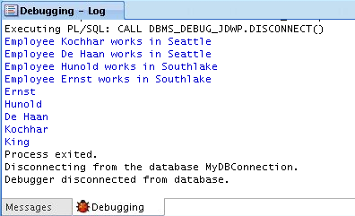
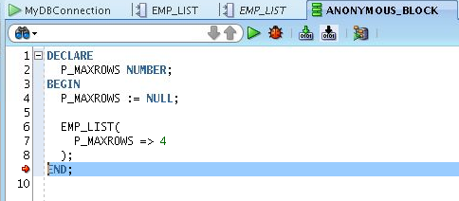
Debugging emp_list:
Step Out of the Code (Shift + F7)
1
2
3
4
5
6
8
7
Notes:
Oracle Database 11g: Develop PL/SQL Program Units 2 - <number>
Debugging emp_list: Step Out of the Code (Shift + F7)
The Step Out of the code option leaves the current subprogram and goes to the next statement subprogram. In the example in the slide, starting with step 3, if you press Shift + F7, program control leaves the procedure and goes to the next statement in the anonymous block. Continuing to press Shift + F7 will take you to the next anonymous block that prints the contents of the SQL buffer.

Slide 45
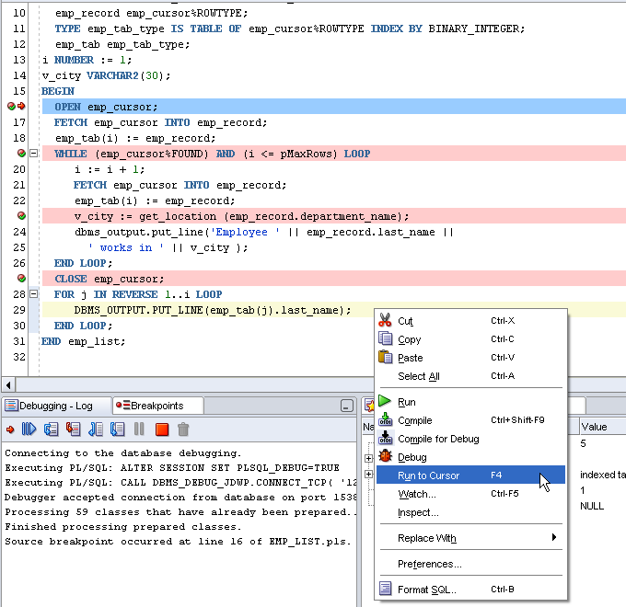
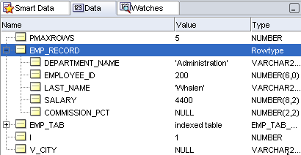
Debugging emp_list: Run to Cursor (F4)
Run to Cursor F4:
Run to your cursor location
without having to single
step or set a breakpoint.
Notes:
Oracle Database 11g: Develop PL/SQL Program Units 2 - <number>
Running to the Cursor Location
When stepping through your application code in the debugger, you may want to run to a particular location without having to single step or set a breakpoint. To run to a specific program location: In a subprogram editor, position your text cursor on the line of code where you want the debugger to stop. You can run to the cursor location using any of the following procedures: In the procedure editor, right-click and choose Run to Cursor, choose the Debug > Run to Cursor option from the main menu, or press F4.
Any of the following conditions may result:
When you run to the cursor, your program executes without stopping, until the execution reaches the location marked by the text cursor in the source editor.
If your program never actually executes the line of code where the text cursor is, the Run to Cursor command will cause your program to run until it encounters a breakpoint or until it finishes.

Slide 46
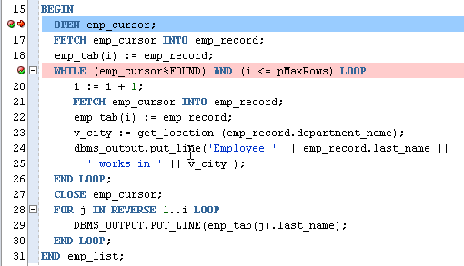


Debugging emp_list: Step to End of Method
Loops until i <> PMAXROWS
Notes:
Oracle Database 11g: Develop PL/SQL Program Units 2 - <number>
Debugging emp_list: Step to End of Method
Step to End of Method goes to the last statement in the current subprogram or to the next breakpoint if there are any in the current subprogram.
In the example in the slide, the Step to End of Method debugging tool is used. Because there is a second breakpoint, selecting Step to End of Method transfers control to that breakpoint. Selecting Step to End of Method again goes through the iterations of the while loop first, and then transfers the program control to the next executable statement in the anonymous block.

Slide 47




Debugging a Subprogram Remotely: Overview
1. Edit procedure
2. Add breakpoints
3. Compile for Debug
6. Issue the debugger
connection command and call
procedure in another
session such as SQL*Plus
5. Enter local machine IP
address and debugging port
4. Select Remote Debug
7. When the breakpoint is reached,
control passes to SQL Developer
8. Debug and monitor data
using debugging tools
Notes:
Oracle Database 11g: Develop PL/SQL Program Units 2 - <number>
Remote Debugging
You can use remote debugging to connect to any PL/SQL code in a database and debug it, regardless of where the database is located as long as you have access to the database and have created a connection to it. Remote debugging is when something else, other than you as a developer, kicks off a procedure that you can then debug. Remote debugging and local debugging have many steps in common. To debug remotely, perform the following steps:
1. Edit the subprogram that you would like to debug.
2. Add the breakpoints in the subprogram.
3. Click the Compile for Debug icon in the toolbar.
4. Right-click the connection for the remote database, and select Remote Debug.
5. In the Debugger - Attach to JPDA dialog box, enter the local machine IP address and port number, such as 4000, and then click OK.
6. Issue the debugger connection command using a different session such as SQL*Plus, and then call the procedure in that session.
7. When a breakpoint is reached, control is passed back to the original SQL Developer session and the debugger toolbar is displayed.
8. Debug the subprogram and monitor the data using the debugging tools discussed earlier.

Slide 48
Practice 2-2 Overview: Introduction to the SQL Developer Debugger
This practice covers the following topics:
  Creating a procedure and a function
  Inserting breakpoints in the procedure
  Compiling the procedure and function for debug mode
  Debugging the procedure and stepping into the code
  Displaying and modifying the subprograms’ variables
Notes:
Oracle Database 11g: Develop PL/SQL Program Units 2 - <number>
Practice 2-2: Overview
You must use SQL Developer for this practice. This practice introduces you to the basic functionality of the SQL Developer debugger.

Slide 49
Summary
In this lesson, you should have learned how to:
  Differentiate between a procedure and a function
  Describe the uses of functions
  Create stored functions
  Invoke a function
  Remove a function
  Understand the basic functionality of the SQL Developer debugger
Notes:
Oracle Database 11g: Develop PL/SQL Program Units 2 - <number>
Summary
A function is a named PL/SQL block that must return a value. Generally, you create a function to compute and return a value, and you create a procedure to perform an action.
A function can be created or dropped.
A function is invoked as a part of an expression.

